Slide 1
Use of Vasopressors and Ionotropes
UCI Internal Medicine
Mini Lecture Series
June 2014

Slide 2
Objective
Discuss physiology of vasopressors and ionotropes
Discuss types of vasopressors and ionotropes
Apply vasopressors and ionotropic agents in clinical scenarios

Slide 3
Vasopressors vs Ionotropes
Vasopressor: an agent that causes vasoconstriction and increases mean arterial pressure
Types: alpha adrenergic, beta adrenergic, dopamine
Ionotrope: an agent that alters the force or energy of muscle contractions (increases cardiac contractility)
Notes:
Some medications have both vasopressor and ionotropic activity

Slide 4
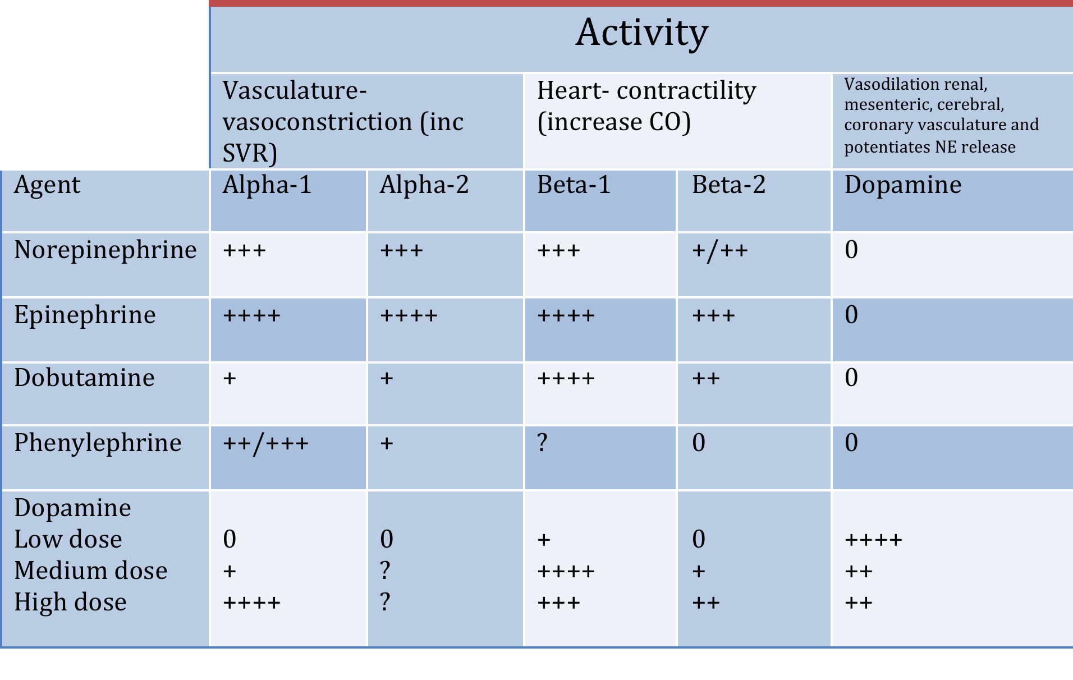
Physiology of Vasopressors and Ionotropes
Notes:
This figure describes the overall effect for vasopressors and ionotropes. It shows the level of activity of each activity at each receptor. Alpha-1 and Alpha-2 receptors work on vasculature to cause vasoconstriction and cause increase in BP. Beta-1 and beta-2 receptors work on the heart and cause increased cardiac contractility. Dopamine has different effects at different doses. At low doses (1-2mcg/kg/min), dopamine causes vasodilation of renal, mesenteric, cerebral and coronary vasculature. At medium doses (5-10mcg/kg/min), it acts on beta receptors and increases cardiac contractility and has a mild increase on BP from alpha adrenergic activity. At high doses (>10mcg/kg/min), it acts mainly on alpha receptors and causes increased vasoconstriction and increased BP.

Slide 5
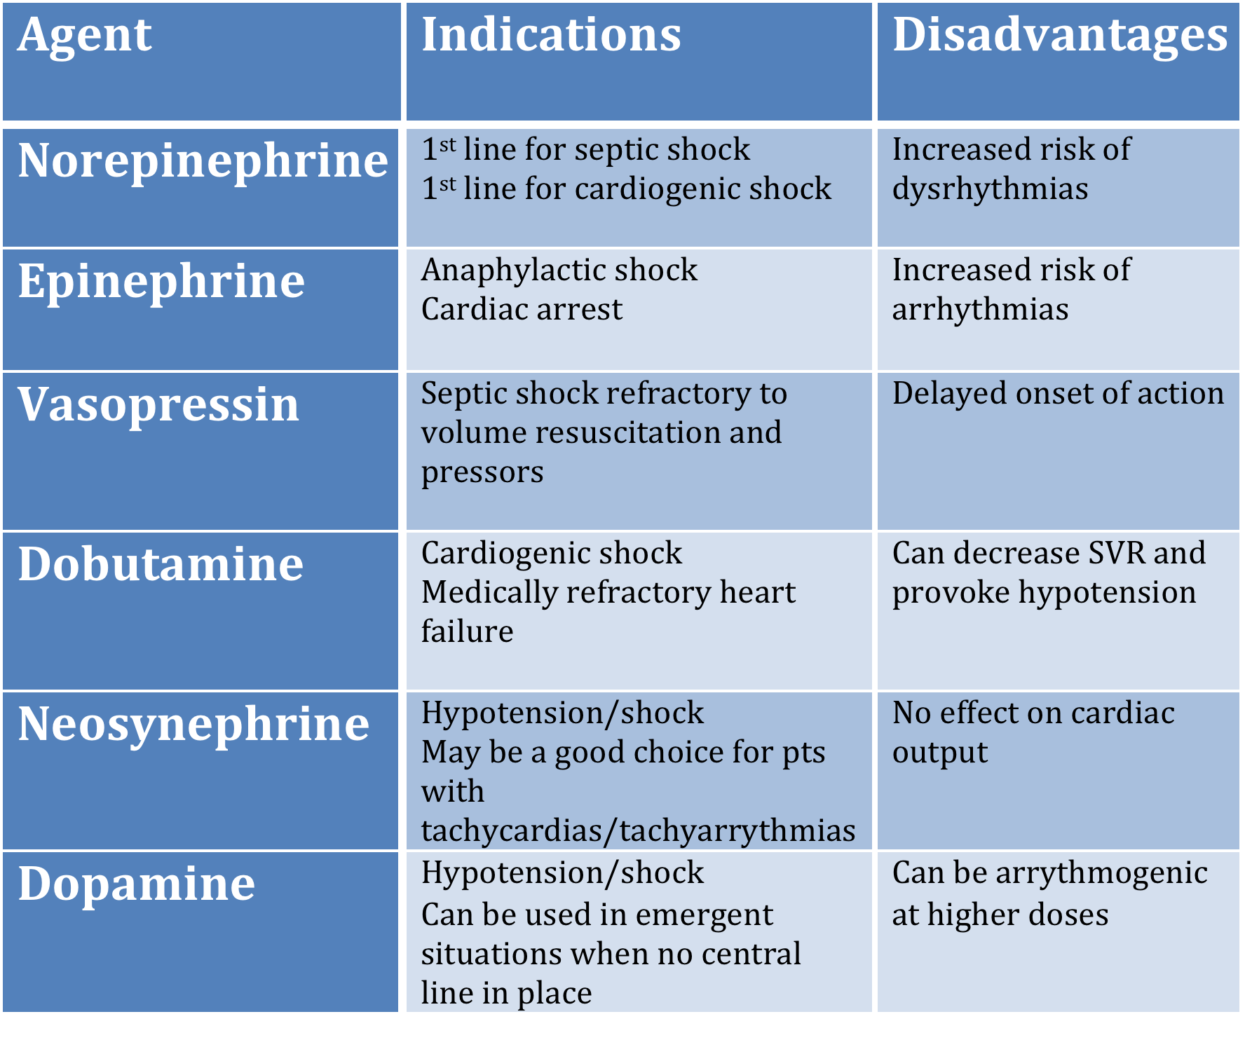
Vasopressors and Ionotropes
Notes:
This table describes the indications and disadvantages for the commonly used pressors.

Slide 6
Choice of Vasopressor Use
Hyperdynamic septic shock
1st line: norepinephrine
2nd line: epinephrine
Vasopressin may also be added
Phenylephrine may be used to pts with tachyarrythmias
Emergent situation when central line not placed yet
Dopamine
Notes:
The next 2 slides discuss pressors used in different clinical situations

Slide 7
Choice of Vasopressor use
Anapylactic shock
Epinephrine
Cardiogenic shock
1st line: norepinephrine
2nd agent: dobutamine
Hypotension following CABG
Epinephrine

Slide 8
Question 1
An 83 year old male with HTN and DM presents to the ED for weakness and cough x 5 days. Vitals are as follows: T 39.4, BP 65/32, P 122. CXR shows right middle lobe consolidation. WBC is 22.and lactic acid is is 7.2. He is treated with IV abx and 5 L of NS. Blood pressure is 71/42. A right internal jugular line is placed. Which of the following agents do you use to treat this patient?
Vasopressin
Dobutamine
Norepinephrine
Dopamine

Slide 9
Answer
An 83 year old male with HTN and DM presents to the ED for weakness and cough x 5 days. Vitals are as follows: T 39.4, BP 65/32, P 122. CXR shows right middle lobe consolidation. WBC is 22.and lactic acid is is 7.2. He is treated with IV abx and 5 L of NS. Blood pressure is 71/42. A right internal jugular line is placed. Which of the following agents do you use to treat this patient?
Vasopressin
Dobutamine
Norepinephrine
Dopamine
Notes:
Answer is C, norepinephrine. This patient has septic shock likely secondary to pneumonia. He has been received adequate fluid resuscitation and needs a vasopressor to maintain his blood pressure. Levophed would be the best case in this scenario as it is the first line for septic shock.

Slide 10
Question 2
A 42 year old male with history of hypertension and diabetes type 1 presents to the hospital for crushing substernal chest pain radiating to his left arm. Troponin is 2.6. EKG shows ST elevations in leads II, III, aVF. Blood pressure is 78/30. Which of the following options has the best combination of pressors to use in this patient?
Dobutamine and levophed
Phenylephrine and epinephrine
Dobutamine and vasopressin
Levophed and dopamine

Slide 11
Answer
A 42 year old male with history of hypertension and diabetes type 1 presents to the hospital for crushing substernal chest pain radiating to his left arm. Troponin is 2.6. EKG shows ST elevations in leads II, III, aVF. Blood pressure is 78/30. Which of the following options has the best combination of pressors to use in this patient?
Dobutamine and levophed
Phenylephrine and epinephrine
Dobutamine and vasopressin
Levophed and dopamine
Notes:
The answer is A. This patient has cardiogenic shock from STEMI. Levophed is first line for cardiogenic shock and since he may need another agent and dobutamine is the best agent because it is indicated in cardiogenic shock.

Slide 12
Question 3
A 21 year old female with no significant past medical history presents to the ED with severe shortness of breath and weakness after eating peanut butter cookies. Her vitals are as follows: BP 82/40, R 30, O2 82%, HR 110. Which of the following agents do you treat her with?
Dobutamine
Vasopressin
Epinephrine
Phenylephrine

Slide 13
Answer
A 21 year old female with no significant past medical history presents to the ED with severe shortness of breath and weakness after eating peanut butter cookies. Her vitals are as follows: BP 82/40, R 30, O2 82%, HR 110. Which of the following agents do you treat her with?
Dobutamine
Vasopressin
Epinephrine
Phenylephrine
Notes:
The answer is C. This patient has anaphylactic shock, thus epinephrine should be used.
Dobutamine is indicated in cardiogenic shock. Vasopressin is used in septic shock refractory to levophed. Phenylephrine is used for shock but is not first line.

Slide 14
Question 4
A 62 year old female is admitted to the Medicine floors with sepsis secondary to UTI. She is being treated with IV antibiotics. Her Blood pressures all day have ranged from 60s-80s/40s-50s. She has received a total of 6L of fluid since admission yesterday and now needs pressor support as she is being transported to the ICU. She does not have a central line in place and it will take some time before it is placed. Which is the best agent to use?
Dopamine
Vasopressin
Dobutamine
Epinephrine

Slide 15
Answer
A 62 year old female is admitted to the Medicine floors with sepsis secondary to UTI. She is being treated with IV antibiotics. Her Blood pressures all day have ranged from 60s-80s/40s-50s. She has received a total of 6L of fluid since admission yesterday and now needs pressor support as she is being transported to the ICU. She does not have a central line in place and it will take some time before it is placed. Which is the best agent to use?
Dopamine
Vasopressin
Dobutamine
Epinephrine
Notes:
This patient has septic shock refractory to fluids. She is unable to have a central line placed at this point and will need pressors though her peripheral IV. Thus, dopamine is the best choice. The other agents require administration via central line.

Slide 16
Summary
Vasopressors should be chosen based on their mechanism of action
Norepinephrine is first line for septic shock and cardiogenic shock
Dobutamine is an ionotropic agent that is used for cardiogenic shock
Epinephrine, phenylephrine, dopamine and vasopressin are other pressors that are routinely used in shock

